Slide 1

Notes:
Reload codespace
Uncheck VS Code tabs

Slide 2
This is CS50
Visit cs50.ly/screen to view projector on your laptop and ask questions via chat.
If you didn't get a rubber duck 🦆 last week, ask Carter during break or after class!
Brownies for snacks today!
No CS50 Lunch this Friday but yes next week.
To learn about "prompt engineering," register for Ready Player 50 at cs50.ly/register!
Do say hi or ask questions during break or after class!

Slide 3
new emoji coming soon!

Slide 4
Notes:
Reload codespace
Uncheck VS Code tabs

Slide 5
learn how to think algorithmically

Slide 6
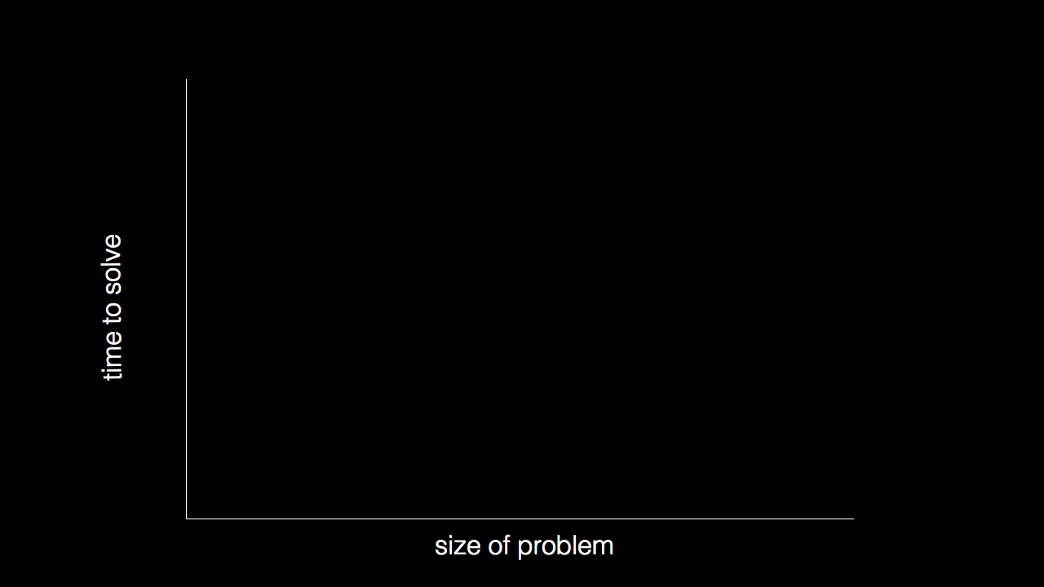

Slide 7
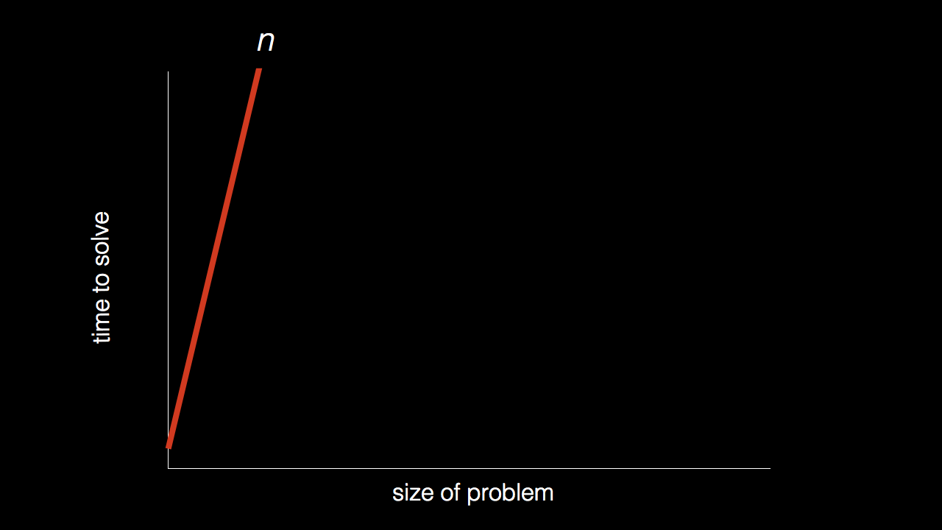
n

Slide 8
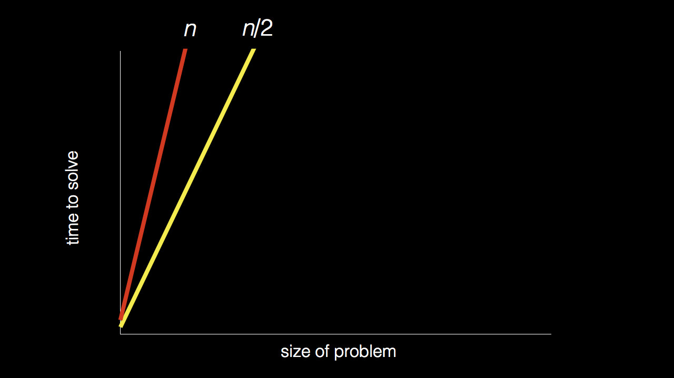
n
n/2

Slide 9
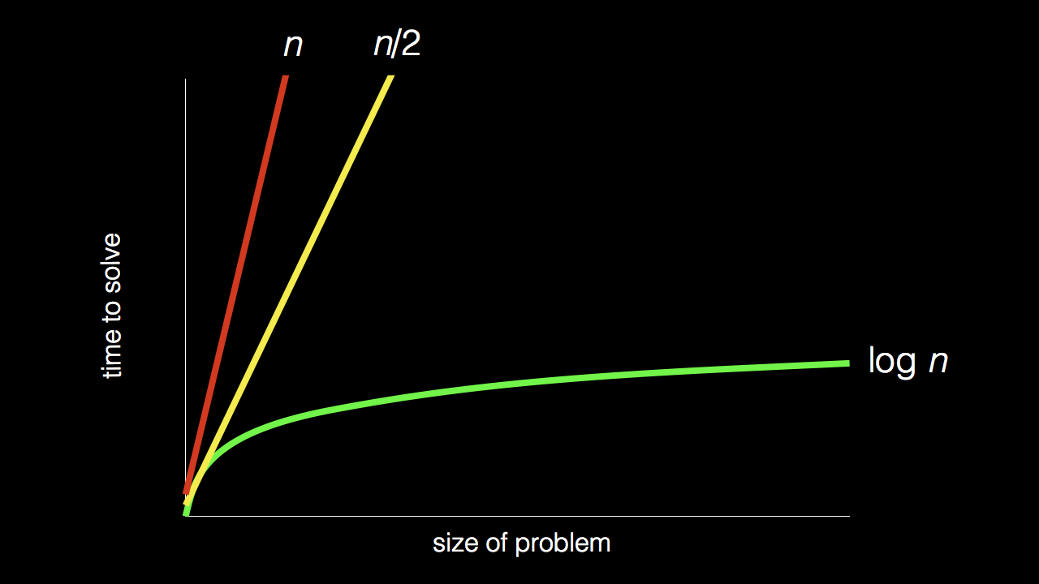
n
n/2
log₂ n

Slide 10
Stand up and think of the number 1.

Slide 11
Stand up and think of the number 1.
Pair off with someone standing, add their number to yours, and remember the sum.

Slide 12
Stand up and think of the number 1.
Pair off with someone standing, add their number to yours, and remember the sum.
One of you should then sit down.

Slide 13
Stand up and think of the number 1.
Pair off with someone standing, add their number to yours, and remember the sum.
One of you should then sit down.
If still standing, go back to step 2.

Slide 14

Notes:
https://apps.apple.com/us/app/contacts/id1069512615#?platform=iphone
In Week 0, intuitive algorithms…
John Harvard

Slide 15
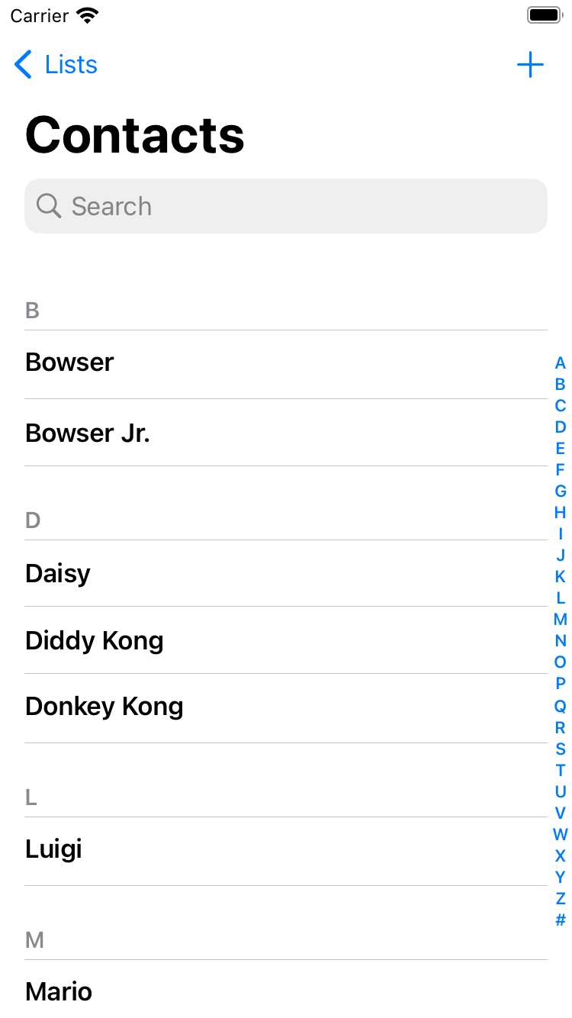
Notes:
https://nintendo.fandom.com/wiki/Nintendo_characters#Mario_series_(including_sub-franchises)

Slide 16
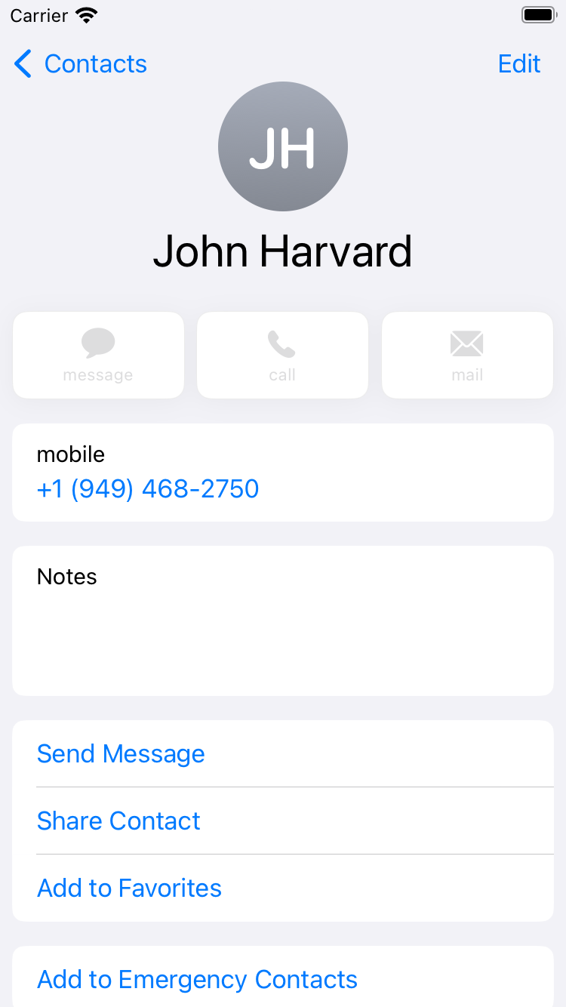

Slide 17
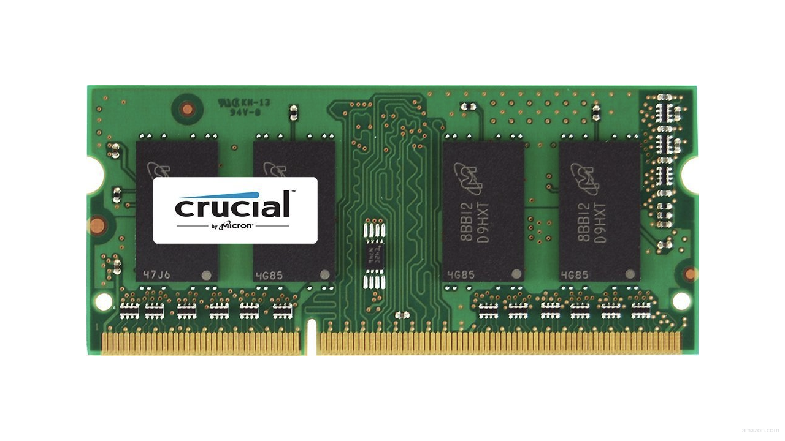

Slide 21
 | 1 | 5 | 10 | 20 | 50 | 100 | 500

Slide 23
 | [0] | [1] | [2] | [3] | [4] | [5] | [6]

Slide 24
 | [0] | [1] | [2] | [3] | [4] | [5] | [6]

Slide 25
searching

Slide 26
input →
→ output

Slide 27

→
→ output

Slide 28
→
→ bool

Slide 29
algorithm

Slide 30
linear search
Notes:
20 500 10 5 100 1 50

Slide 31
For each door from left to right
If 50 is behind door
Return true
Return false

Slide 32
For each door from left to right
If 50 is behind door
Return true
Else
Return false

Slide 33
For each door from left to right
If 50 is behind door
Return true
Return false

Slide 34
For i from 0 to n-1
If 50 is behind doors[i]
Return true
Return false

Slide 35
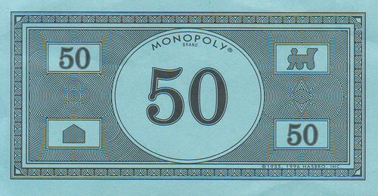
Notes:
https://www.pinterest.com/pin/525443481522247447/

Slide 36
binary search
Notes:
1 5 10 20 50 100 500

Slide 37
If 50 is behind middle door
Return true
Else if 50 < middle door
Search left half
Else if 50 > middle door
Search right half

Slide 38
If no doors left
If 50 is behind middle door
Return true
Else if 50 < middle door
Search left half
Else if 50 > middle door
Search right half

Slide 39
If no doors left
Return false
If 50 is behind middle door
Return true
Else if 50 < middle door
Search left half
Else if 50 > middle door
Search right half

Slide 40
If no doors left
Return false
If 50 is behind doors[middle]
Return true
Else if 50 < doors[middle]
Search doors[0] through doors[middle - 1]
Else if 50 > doors[middle]
Search doors[middle + 1] through doors[n - 1]

Slide 41
running time

Slide 42
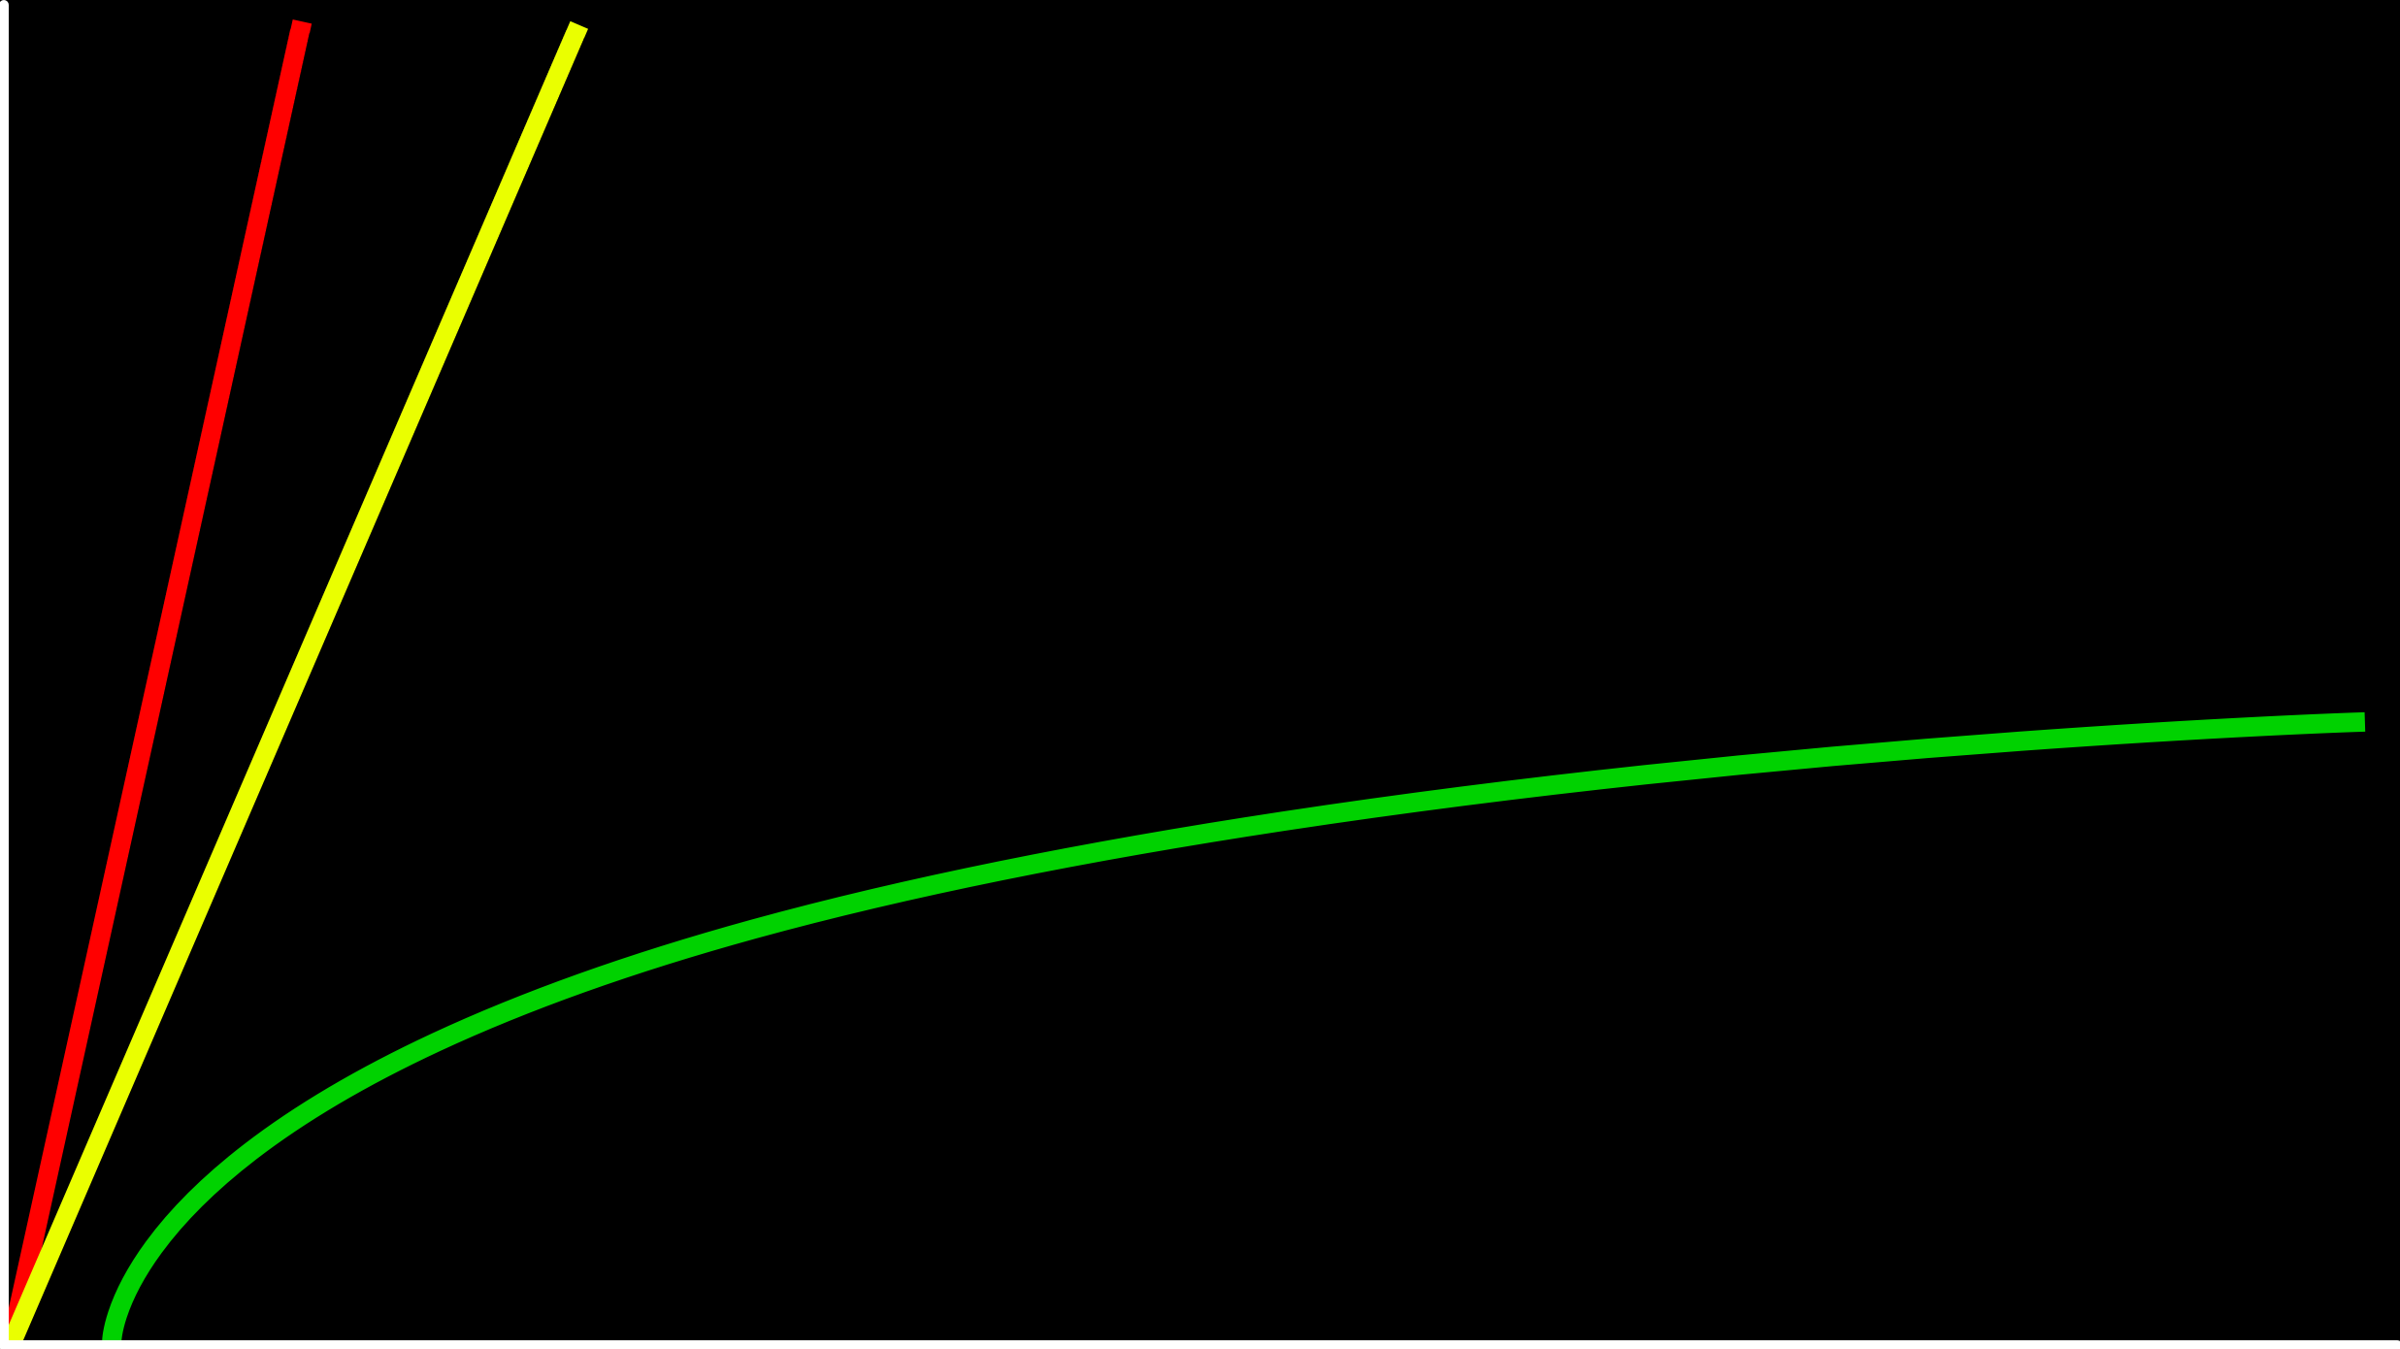
time to solve
size of problem

Slide 43
O(n)
O(n/2)
time to solve
O(log₂n)
size of problem

Slide 44
O(n)
O(n/2)
time to solve
O(log₂n)
size of problem

Slide 45
O(n)
O(n)
time to solve
O(log₂n)
size of problem

Slide 46
O(n)
O(n)
time to solve
O(log n)
size of problem

Slide 47
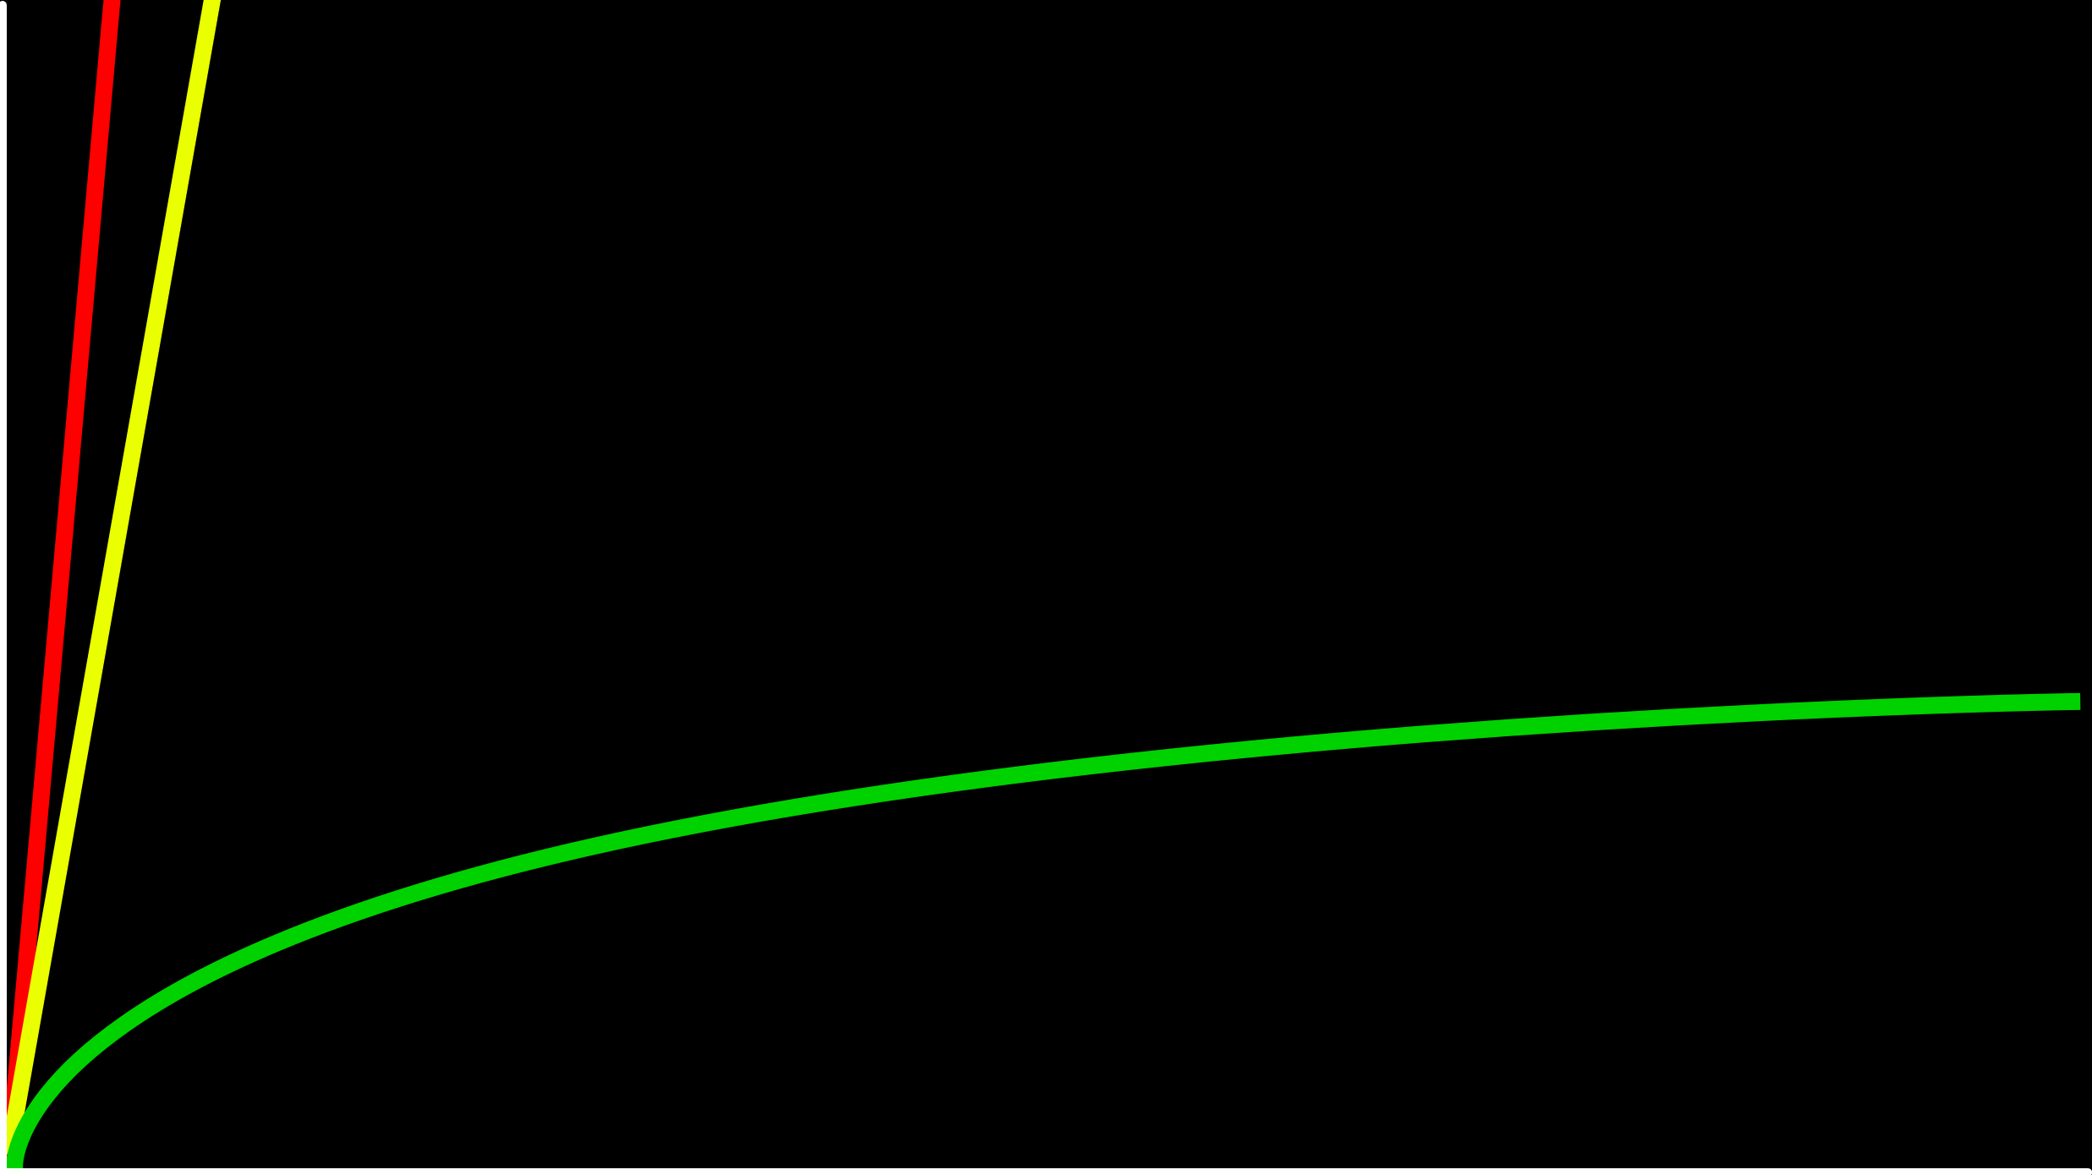
O(n)
time to solve
O(log n)
size of problem

Slide 48
O
Worst case

Slide 49
O(n²)
O(n log n)
O(n)
O(log n)
O(1)
how long to take for everyone to shake hands?
n people doing n things is O(n²)
each n person must shake hands with (n-1) others so n(n-1)
Notes:
linear? binary?

Slide 50
O(n²)
O(n log n)
O(n) linear search
O(log n)
O(1)

Slide 51
O(n²)
O(n log n)
O(n) linear search
O(log n) binary search
O(1)

Slide 52
Ω
Best case

Slide 53
Ω(n²)
Ω(n log n)
Ω(n)
Ω(log n)
Ω(1)
Notes:
linear? binary?

Slide 54
Ω(n²)
Ω(n log n)
Ω(n)
Ω(log n)
Ω(1) linear search

Slide 55
Ω(n²)
Ω(n log n)
Ω(n)
Ω(log n)
Ω(1) linear search, binary search

Slide 56
Θ
When worst case is also best case

Slide 57
Θ(n²)
Θ(n log n)
Θ(n)
Θ(log n)
Θ(1)
counting everyone

Slide 58
linear search
Notes:
search{0,1}.c

Slide 59
string.h

Slide 60
manual.cs50.io/#string.h

Slide 61
strcmp
Notes:
phonebook0.c

Slide 62
data structures

Slide 63
person people[]

Slide 64
string name;
string number;

Slide 65
typedef struct
{
string name;
string number;
}
person;
Notes:
phonebook1.c
we'll see a way to save phonebook eventually

Slide 66
typedef struct
{
string name;
string number;
} person;

Slide 67
sorting

Slide 68
input →
→ output

Slide 69
unsorted →
→ output

Slide 70
unsorted →
→ sorted

Slide 71
→
→ sorted
7 2 5 4 1 6 0 3

Slide 72
→
→
7 2 5 4 1 6 0 3
0 1 2 3 4 5 6 7

Slide 73
→
→
7 2 5 4 1 6 0 3
0 1 2 3 4 5 6 7

Slide 74
7 2 5 4 1 6 0 3
Notes:
volunteers: sort themselves, then selection, then bubble

Slide 75
selection sort
Notes:
https://www.cs.usfca.edu/~galles/visualization/ComparisonSort.html

Slide 76
7 2 5 4 1 6 0 3

Slide 77
For i from 0 to n-1
Find smallest number between numbers[i] and numbers[n-1]
Swap smallest number with numbers[i]

Slide 78
 | [0] | [1] | [2] | ... | [n-3] | [n-2] | [n-1]

Slide 80
(n – 1)

Slide 81
(n – 1) + (n – 2)

Slide 82
(n – 1) + (n – 2) + (n – 3)

Slide 83
(n – 1) + (n – 2) + (n – 3) + ... + 1

Slide 84
(n – 1) + (n – 2) + (n – 3) + ... + 1
n(n – 1)/2

Slide 85
(n – 1) + (n – 2) + (n – 3) + ... + 1
n(n – 1)/2
(n² – n)/2

Slide 86
(n – 1) + (n – 2) + (n – 3) + ... + 1
n(n – 1)/2
(n² – n)/2
n²/2 – n/2

Slide 87
(n – 1) + (n – 2) + (n – 3) + ... + 1
n(n – 1)/2
(n² – n)/2
n²/2 – n/2
O(n²)

Slide 88
O(n²)
O(n log n)
O(n)
O(log n)
O(1)

Slide 89
O(n²) selection sort
O(n log n)
O(n)
O(log n)
O(1)

Slide 90
For i from 0 to n-1
Find smallest number between numbers[i] and numbers[n-1]
Swap smallest number with numbers[i]
Notes:
what about lower bound?

Slide 91
 | [0] | [1] | [2] | ... | [n-3] | [n-2] | [n-1]

Slide 92
Ω(n²)
Ω(n log n)
Ω(n)
Ω(log n)
Ω(1)

Slide 93
Ω(n²) selection sort
Ω(n log n)
Ω(n)
Ω(log n)
Ω(1)

Slide 94
Θ(n²)
Θ(n log n)
Θ(n)
Θ(log n)
Θ(1)

Slide 95
Θ(n²) selection sort
Θ(n log n)
Θ(n)
Θ(log n)
Θ(1)

Slide 96
bubble sort
Notes:
https://www.cs.usfca.edu/~galles/visualization/ComparisonSort.html

Slide 97
7 2 5 4 1 6 0 3

Slide 98
Repeat n times
For i from 0 to n-2
If numbers[i] and numbers[i+1] out of order
Swap them
(n-1) since last one must be in right spot
1 to (n-1) is (n-1)
Notes:
https://www.cs.usfca.edu/~galles/visualization/ComparisonSort.html

Slide 99
Repeat n-1 times
For i from 0 to n-2
If numbers[i] and numbers[i+1] out of order
Swap them
Notes:
https://www.cs.usfca.edu/~galles/visualization/ComparisonSort.html

Slide 100
 | [0] | [1] | [2] | ... | [n-3] | [n-2] | [n-1]

Slide 102
(n – 1) × (n – 1)

Slide 103
(n – 1) × (n – 1)
n² – 1n – 1n + 1

Slide 104
(n – 1) × (n – 1)
n² – 1n – 1n + 1
n² – 2n + 1

Slide 105
(n – 1) × (n – 1)
n² – 1n – 1n + 1
n² – 2n + 1
O(n²)

Slide 106
O(n²)
O(n log n)
O(n)
O(log n)
O(1)

Slide 107
O(n²) bubble sort
O(n log n)
O(n)
O(log n)
O(1)

Slide 108
Repeat n-1 times
For i from 0 to n-2
If numbers[i] and numbers[i+1] out of order
Swap them

Slide 109
Repeat n-1 times
For i from 0 to n-2
If numbers[i] and numbers[i+1] out of order
Swap them
If no swaps
Quit

Slide 110
Ω(n²)
Ω(n log n)
Ω(n)
Ω(log n)
Ω(1)

Slide 111
Ω(n²)
Ω(n log n)
Ω(n) bubble sort
Ω(log n)
Ω(1)

Slide 112
recursion

Slide 113
If no doors left
Return false
If number behind middle door
Return true
Else if number < middle door
Search left half
Else if number > middle door
Search right half

Slide 114
If no doors left
Return false
If number behind middle door
Return true
Else if number < middle door
Search left half
Else if number > middle door
Search right half

Slide 115
1 Pick up phone book
2 Open to middle of phone book
3 Look at page
4 If person is on page
5 Call person
6 Else if person is earlier in book
7 Open to middle of left half of book
8 Go back to line 3
9 Else if person is later in book
10 Open to middle of right half of book
11 Go back to line 3
12 Else
13 Quit

Slide 116
1 Pick up phone book
2 Open to middle of phone book
3 Look at page
4 If person is on page
5 Call person
6 Else if person is earlier in book
7 Open to middle of left half of book
8 Go back to line 3
9 Else if person is later in book
10 Open to middle of right half of book
11 Go back to line 3
12 Else
13 Quit

Slide 117
1 Pick up phone book
2 Open to middle of phone book
3 Look at page
4 If person is on page
5 Call person
6 Else if person is earlier in book
7 Open to middle of left half of book
8 Go back to line 3
9 Else if person is later in book
10 Open to middle of right half of book
11 Go back to line 3
12 Else
13 Quit

Slide 118
1 Pick up phone book
2 Open to middle of phone book
3 Look at page
4 If person is on page
5 Call person
6 Else if person is earlier in book
7 Search left half of book
8
9 Else if person is later in book
10 Search right half of book
11
12 Else
13 Quit

Slide 119
1 Pick up phone book
2 Open to middle of phone book
3 Look at page
4 If person is on page
5 Call person
6 Else if person is earlier in book
7 Search left half of book
8 Else if person is later in book
9 Search right half of book
10 Else
11 Quit

Slide 120

Notes:
http://ian-albert.com/games/super_mario_bros_maps/

Slide 121
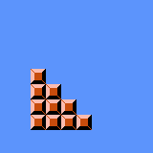
Notes:
iteration.c

Slide 122


Slide 123


Slide 124


Slide 125

Notes:
recursion{0,1}.c

Slide 126
google.com/search?q=recursion

Slide 127
merge sort

Slide 128
Sort left half of numbers
Sort right half of numbers
Merge sorted halves

Slide 129
If only one number
Quit
Else
Sort left half of numbers
Sort right half of numbers
Merge sorted halves

Slide 130
If only one number
Quit
Else
Sort left half of numbers
Sort right half of numbers
Merge sorted halves

Slide 131
1 3 4 6 0 2 5 7
Notes:
shelves

Slide 132
If only one number
Quit
Else
Sort left half of numbers
Sort right half of numbers
Merge sorted halves
Notes:
https://www.cs.usfca.edu/~galles/visualization/ComparisonSort.html

Slide 133
6 3 4 1 5 2 7 0
Notes:
shelves

Slide 134
6 | 3 | 4 | 1 | 5 | 2 | 7 | 0

Slide 135
6 | 3 | 4 | 1 | 5 | 2 | 7 | 0

Slide 136
 |  |  |  | 5 | 2 | 7 | 0
6 | 3 | 4 | 1

Slide 137
 |  |  |  | 5 | 2 | 7 | 0
 |  | 4 | 1
6 | 3

Slide 138
 |  |  |  | 5 | 2 | 7 | 0
 |  | 4 | 1
 | 3
6

Slide 139
 |  |  |  | 5 | 2 | 7 | 0
 |  | 4 | 1
6
3

Slide 140
 |  |  |  | 5 | 2 | 7 | 0
 |  | 4 | 1
3
6

Slide 141
 |  |  |  | 5 | 2 | 7 | 0
 |  | 4 | 1
3 | 6

Slide 142
 |  |  |  | 5 | 2 | 7 | 0
3 | 6
4 | 1

Slide 143
 |  |  |  | 5 | 2 | 7 | 0
3 | 6
 | 1
4

Slide 144
 |  |  |  | 5 | 2 | 7 | 0
3 | 6
4
1

Slide 145
 |  |  |  | 5 | 2 | 7 | 0
3 | 6
1
4

Slide 146
 |  |  |  | 5 | 2 | 7 | 0
3 | 6
1 | 4

Slide 147
 |  |  |  | 5 | 2 | 7 | 0
1
3 | 6
 | 4

Slide 148
 |  |  |  | 5 | 2 | 7 | 0
1 | 3
 | 6
 | 4

Slide 149
 |  |  |  | 5 | 2 | 7 | 0
1 | 3 | 4
 | 6

Slide 150
 |  |  |  | 5 | 2 | 7 | 0
1 | 3 | 4 | 6

Slide 151
1 | 3 | 4 | 6
5 | 2 | 7 | 0

Slide 152
1 | 3 | 4 | 6
 |  | 7 | 0
5 | 2

Slide 153
1 | 3 | 4 | 6
 |  | 7 | 0
 | 2
5

Slide 154
1 | 3 | 4 | 6
 |  | 7 | 0
5
2

Slide 155
1 | 3 | 4 | 6
 |  | 7 | 0
2
5

Slide 156
1 | 3 | 4 | 6
 |  | 7 | 0
2 | 5

Slide 157
1 | 3 | 4 | 6
2 | 5
7 | 0

Slide 158
1 | 3 | 4 | 6
2 | 5
 | 0
7

Slide 159
1 | 3 | 4 | 6
2 | 5
7
0

Slide 160
1 | 3 | 4 | 6
2 | 5
0
7

Slide 161
1 | 3 | 4 | 6
2 | 5
0 | 7

Slide 162
1 | 3 | 4 | 6
0
2 | 5
 | 7

Slide 163
1 | 3 | 4 | 6
0 | 2
 | 5
 | 7

Slide 164
1 | 3 | 4 | 6
0 | 2 | 5
 | 7

Slide 165
1 | 3 | 4 | 6
0 | 2 | 5 | 7

Slide 166
0
1 | 3 | 4 | 6
 | 2 | 5 | 7

Slide 167
0 | 1
 | 3 | 4 | 6
 | 2 | 5 | 7

Slide 168
0 | 1 | 2
 | 3 | 4 | 6
 |  | 5 | 7

Slide 169
0 | 1 | 2 | 3
 |  | 4 | 6
 |  | 5 | 7

Slide 170
0 | 1 | 2 | 3 | 4
 |  |  | 6
 |  | 5 | 7

Slide 171
0 | 1 | 2 | 3 | 4 | 5
 |  |  | 6
 |  |  | 7

Slide 172
0 | 1 | 2 | 3 | 4 | 5 | 6
 |  |  | 7

Slide 173
0 | 1 | 2 | 3 | 4 | 5 | 6 | 7

Slide 174
0 | 1 | 2 | 3 | 4 | 5 | 6 | 7

Slide 175
O(n²)
O(n log n)
O(n)
O(log n)
O(1)

Slide 176
6 | 3 | 4 | 1 | 5 | 2 | 7 | 0
6 | 3 | 4 | 1
5 | 2 | 7 | 0
6 | 3
4 | 1
5 | 2
7 | 0
6
3
4
1
5
2
7
0

Slide 177
6 | 3 | 4 | 1 | 5 | 2 | 7 | 0
6 | 3 | 4 | 1
5 | 2 | 7 | 0
6 | 3
4 | 1
5 | 2
7 | 0
6
3
4
1
5
2
7
0

Slide 178
log₂ n

Slide 179
log₂ 8

Slide 180
log₂ 2³

Slide 181
3

Slide 182
8 numbers
3 rows
8 * 3 = 24
height = log(n)
width = n
n log(n)
6 | 3 | 4 | 1 | 5 | 2 | 7 | 0
6 | 3 | 4 | 1
5 | 2 | 7 | 0
6 | 3
4 | 1
5 | 2
7 | 0
6
3
4
1
5
2
7
0

Slide 183
n log₂ n

Slide 184
n log n

Slide 185
O(n²)
O(n log n) merge sort
O(n)
O(log n)
O(1)

Slide 186
Ω(n²)
Ω(n log n) merge sort
Ω(n)
Ω(log n)
Ω(1)

Slide 187
Θ(n²)
Θ(n log n) merge sort
Θ(n)
Θ(log n)
Θ(1)

Slide 188
6 | 3 | 4 | 1 | 5 | 2 | 7 | 0
6 | 3 | 4 | 1
5 | 2 | 7 | 0
6 | 3
4 | 1
5 | 2
7 | 0
6
3
4
1
5
2
7
0

Slide 189
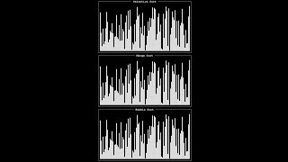
Notes:
Source: https://www.youtube.com/watch?v=ZZuD6iUe3Pc
https://www.youtubeeducation.com/watch?v=3WDWH59k1q4

Slide 190
Sorting Algorithm Visualizer
https://www.cs.usfca.edu/~galles/visualization/ComparisonSort.html
https://www.toptal.com/developers/sorting-algorithms

Slide 191
Notes:
Reload codespace
Uncheck VS Code tabs

